Slide 1


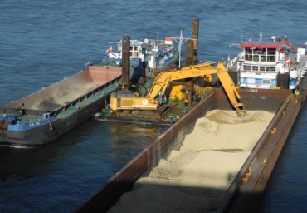



Importance of innovative transport concepts for inland navigation

Slide 2
How to work with this learning material
Power Point
  the following power point presents innovative transport concept and their relevance for inland navigation. The slides are shortly described in the notes below and you can also find the link to the source if you need further information.
Reader
  In addition to the power point presentation, you can also use the reader provided on our platform. It’s more detailed and could be used as a script.
Links
  You can also find the sources of our presentation and reader in the links section of the relevant bundled teaching material.
Videos
    There are also different videos used as sources in this presentation. You can find these videos separately in the relevant bundled teaching material.

Slide 3
Agenda
Importance of innovative transport concepts for inland navigation
Freight transport
Physical Internet
Multimodal transport concepts
Synchromodality
Notes:
At the beginning of this presentation the current situation of freight transport in Europe is presented to show how important new transport concepts are. Afterwards the evolution of multimodal transport concepts as well as its influencing factors are described. In the last two sections of this presentation two innovative transport concepts, which can be named as important ones for inland navigation, are presented.

Slide 4
Spheres of influence in freight transport
Environment: society - economy - politics
Offered freight service
infrastructure
new technologies
Freight transport demand
companies
spare capacity
competition on market
distribution strategies
traffic distribution
sourcing strategies
Modal Split
Areas of tension
freight companies
customers
Notes:
Freight transport and therefore the modal split is in particular influenced by the offered freight service which depends among others on new technologies, infrastructure, spare capacity and competition on the market. In fact the current increase of transport volume leads to a big bottle-neck in the transport infrastructure. In addition the environment and therefore society, economy and politics influence the development of freight transport. For instance the increasing interest of society for sustainable transport influences offered freight service as well as political actions like the ban of trucks on highways for certain times.
Furthermore the demand for freight transport is defined by e.g. the sourcing and distribution strategies of different companies. Also the choice of the different transport modes by companies influence the demand. This can lead to areas of tension for freight companies and customers who both have different transport requirements. For example: Whereas freight companies want to exploit the entire capacity of the transportation means, customers want a short delivery time and low transportation costs.
In summary, the modal split depends on a lot of different factors that simultaneously influence each other and need to be considered.
Source:
Holderied, Cornelius: Güterverkehr, Spedition und Logistik. Managementkonzepte für Güterverkehrsbetriebe, Speditionsunternehmen und logistische Dienstleister, München, 2005 p.17-34
Bretzke, Wolf-Rüdiger/Karmin Barkawi: Nachhaltige Logistik: Antworten auf eine globale Herausforderung. Berlin Heidelberg, 2010
p.33ff

Slide 5
Megatrends influencing freight transport
logistic
safety
Climate
change
urbanization
E-commerce
digitalization
mobile world
New transport concepts
Notes:
There are a few megatrends which are influencing the future of logistic and therefore also freight transport.
In times of terrorism safety has become a very important topic. Therefore parcels, containers and other transport units need to pass security checks at different points of the supply chain. In addition shippers, logistic service providers and transport companies have to make sure that supply chains aren‘t misused by terrorists.
The consequences of climate change are more and more visible, what makes sustainable strategies necessary. In fact a view appropriate actions have already been made: transport vehicles need to respect certain emission limits and new fuels like LNG (liquefied natural gas), which is especially attractive for inland navigation, are growing in importance. The increasing size of cities leads to problems for logistic service providers because of the bottlenecks in the infrastructure. One possibility to reduce freight traffic in cities is by installing Urban Consolidation Centers (UCC) outside the cities so bundle the transport streams towards cities.
Online retailing and therefore E-commerce depends on the internet and logistic. Since logistic is a major part of the service a few online-retailers are also transport service providers to perform the delivery.
In connection with digitalization, offers like the 3D-printer lead to a compressed supply chain because production, e.g. the printing of spare parts, can be performed where the product is needed. Therefore long transport distances can be minimized because spare parts don‘t need to be ordered from the manufacturer who may be located in Asia.
Due to the increasing interfaces between different devices, which are connected via the internet, a mobile world is emerging. Besides smart phones also houses or transport vehicles can be connected and remotely controlled by defined users. For instance, if you expect a delivery while you are at work and the delivery agent is ringing at your door, you get called on your smartphone and you can open the door for the delivery agent via your smart phone.
Source:
Lehmacher W. (2015): Wirtschaft, Gesellschaft und Logistik 2050 in Logistik – eine Industrie, die (sich) bewegt. Strategien und Lösungen entlang der Supply Chain 4.0
p.9-15

Slide 6
Freight Transport in Europe
2013
2050
+ 57% total freight transport activity
+ 55% increase of truck transport
bottle-necks in transport infrastructure
international freight will increase → longer transport distances
increase of energy costs
public and political pressure
*distribution of total transport on different means of transport
source: Eurostat
Notes:
As the modal split in Europe in 2013 shows, truck remains to have the highest share in the modal split followed by train. The forecasted increase of truck transport by 55% between 2010 and 2050 in combination with a general increase of total freight transport activity of 57% in the same period shows that new transport concepts are desperately needed because of the bottle-necks in the transport infrastructure. Since international freight will continue to increase longer transport distances of raw materials or end products are the consequence. In combination with the increasing energy costs one may say that the transport chain therefore needs to be well planned to guarantee minimal costs for the shipper and also for the customer. Moreover political and public goals like the focus on sustainable transport modes make it necessary to rethink the current structure of freight transport.
Sources:
http://ec.europa.eu/eurostat/statistics-explained/index.php/Freight_transport_statistics_-_modal_split
http://ec.europa.eu/transport/media/publications/doc/trends-to-2050-update-2013.pdf p.39
http://www.oecd-http://www.oecd-ilibrary.org/docserver/download/7414021e.pdf?expires=1457012730&id=id&accname=ocid56027859&checksum=F3F96F396835D30F46A01AD6921DC83C p.28,75,76

Slide 7
Drivers for new transport concepts in freight transport
Efficient match of supply and demand
  resources (CO₂ , infrastructure)
  higher transport costs = higher consumer price
Future developments
  increasing transport volume ←→ bottle-necks in infrastructure
  environment (society, economy, politics)
  importance of technology
Transport - quality improvement and cost reduction by:
  using modern communication and information technologies
  efficient combination of transport modes/vehicles
  optimized route-planning
  bundling effects
  combining different transport modes = multimodal transport
Notes:
In summary, some drivers for new transport concepts in freight transport can be identified: first the efficient match of supply and demand in the context of resources is important to minimize CO2 emissions and to guarantee an efficient use of the existing infrastructure. In addition transportation costs have a direct impact on the consumer price – this means that because consumers aren‘t willing to pay a high price for transportation services, latter need to be planned efficiently to guarantee low transport costs and simultaneously operate efficiently. This makes full utilization of the transport modes necessary.
Furthermore the future developments like the increasing transport volume in contrast to the bottle-necks in infrastructure, the shift in the importance of different transportation corridors, the different influences of the environment (like new laws adopted by politics concerning emission limits or an increasing demand for biological food from society) and the increasing importance of technology in freight transport make new transport concepts necessary.
As a consequence quality improvement and cost reduction in transport is possible by using modern communication and information technologies, the efficient combination of transport modes/vehicles, by optimizing route-planning to guarantee an efficient use of the available resources and by bundling transport streams at certain points to minimize the frequency of transports(especially in cities).
One essential characteristic of the freight transport in the future is that the different transport modes are more often combined (technical, at transportation flows).

Slide 8
Agenda
Importance of innovative transport concepts for inland navigation
Freight transport
Physical Internet
Multimodal transport concepts
Synchromodality

Slide 9
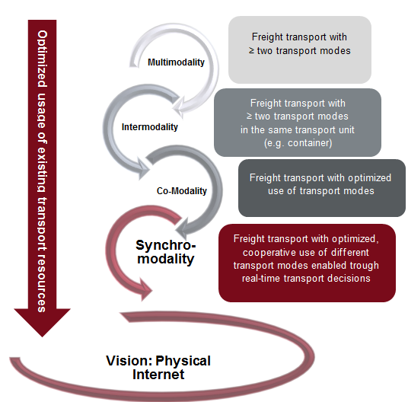




Chronological evolution of freight transport concepts
+
+
+
+
+/-
+/-
+
+
Notes:
Since transport is expected to grow in the future, Europe needs to adequately accommodate this transport and therefore face the challenge that only two transport modes (road and rail) are available in many cases whereas a big part of Europe lack inland waterways. As a consequence, European transport chains often lack sufficient capacity because infrastructure has reached its maximum. This is also in accordance with the current traffic jam situation in Europe. In addition sustainability and therefore the optimal use of existing transport resources is increasingly important for freight transport to guarantee efficient and cheap transport for the future. Therefore different transport concepts have evolved during the last years and set the path to further developments respecting the named challenges:
The usage of different transport modes to bundle the strengths of each transport mode is the idea of multimodality. Intermodality facilities the use of different transport modes by shipping products in the same transport unit and therefore lower the handling costs. To use the transport mode best suitable for the different transport routes (depending e.g. on the product) is the idea of co-modality.
Synchromodality combines the best aspects of the previous concepts – standardized transport units over all transport modes, bundle strengths of different transport modes, avoid unimodal transport- by adding real-time data to guarantee the most efficient transport. The concept of synchromodality can also be seen as a first steps towards the physical internet, which was first introduced by the Canadian professor Benoit Montreuil. In the physical internet there are anonymized shipments and the transport is organized on its own through a constant data exchange. The physical internet is also discussed in the last section of this presentation!
Sources:
Results of Internal report „SynChain“ (2015) – for further information about the used source please contact us
http://www.informatie.binnenvaart.nl/documenten/doc_view/158-the-future-of-freight-transport-ect-s-vision-on-sustainable-and-reliable-european-transport (slide 5-11)

Slide 10
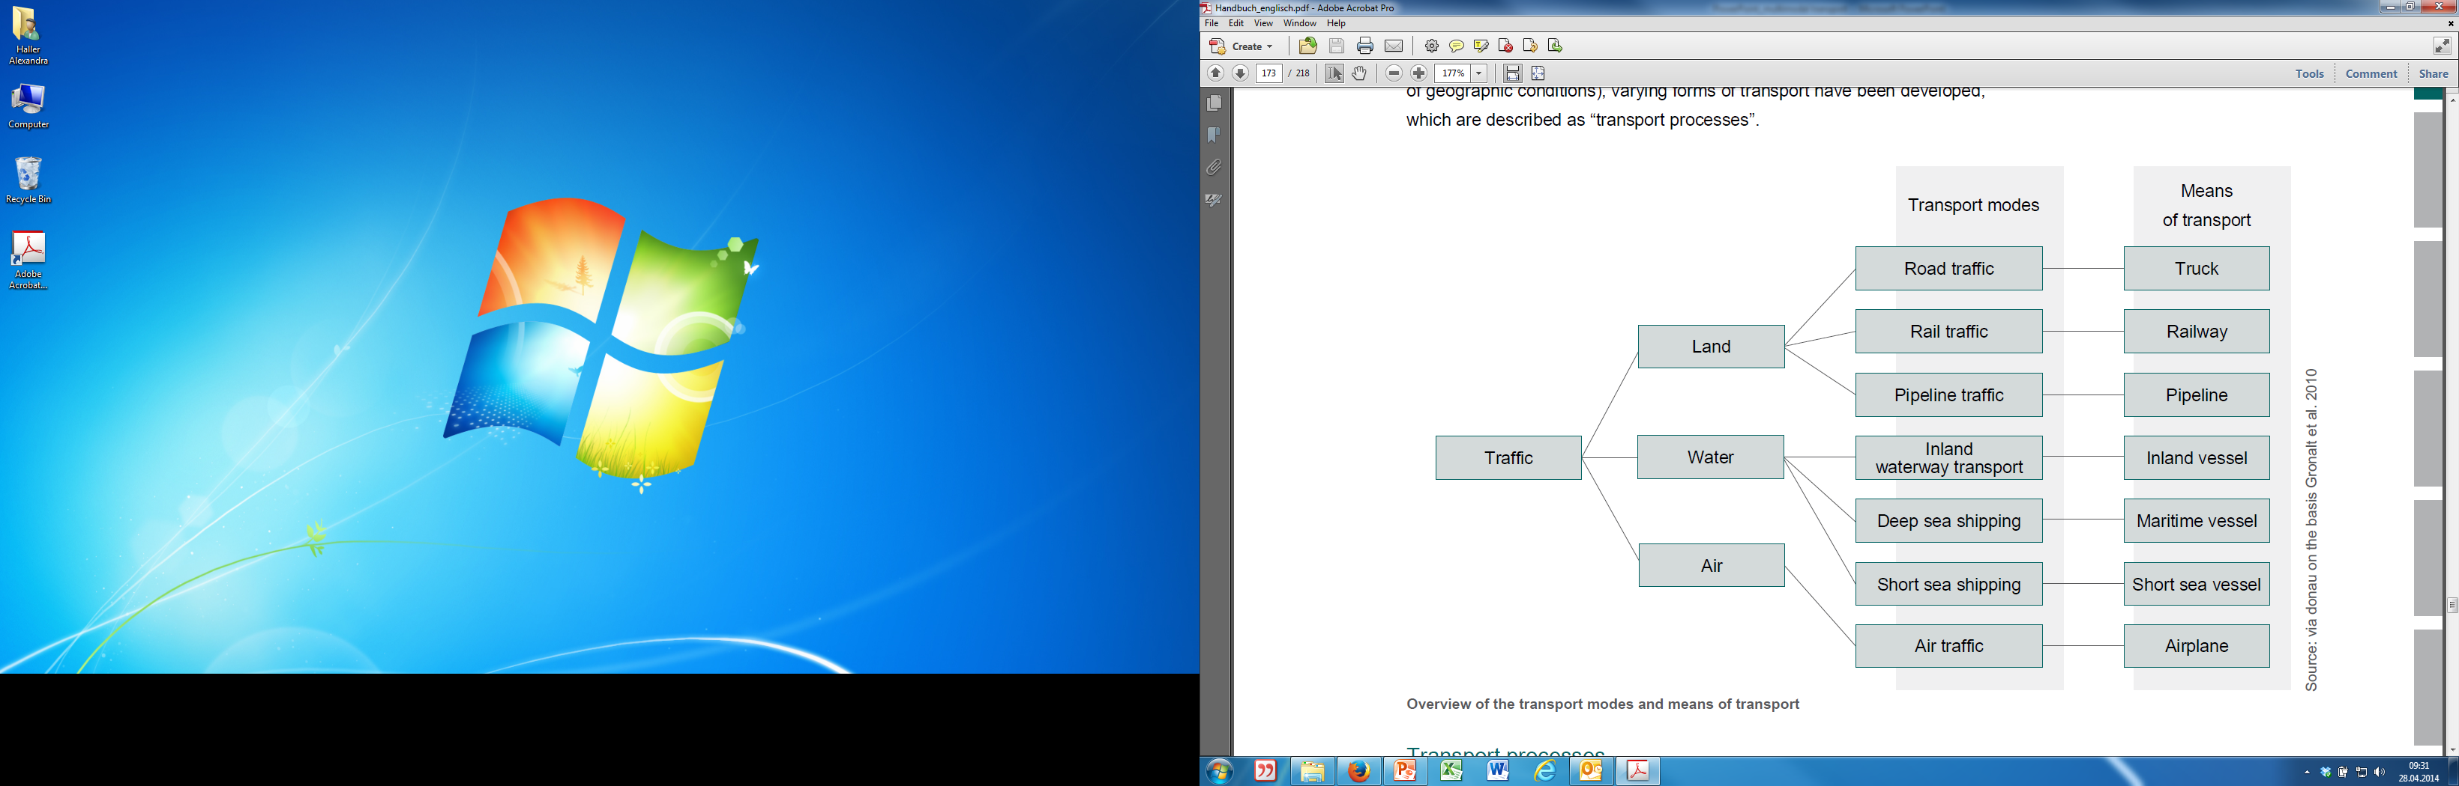
Terminology
Means of transport: vehicles that serve to goods and passengers such as trucks, trains or inland vessels
Mode of transport:
transport infrastructure (such a
roads, rail, inland waterways,…)
Pre-haulage: partial route at the beginning of the transport chain (often by truck)
End-haulage: last part of the transport chain, to the recipient (often by truck)
Notes:
In the next slides some definitions will be named. Therefore a brief description of important terms should be given.
Viadonau „Manual on Danube Navigation“, p. 172-175.

Slide 11
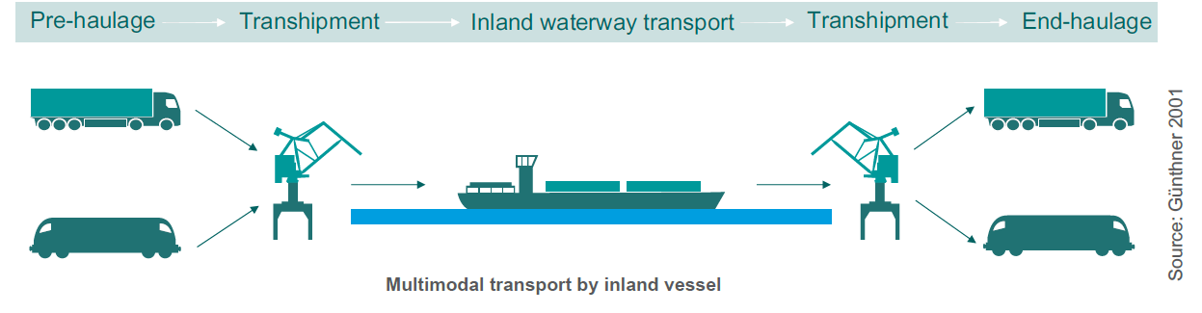
Multimodal Transport
Definition:
  transport of goods using two or more means of transport
Advantages and Usage:
  optimized combination/usage of vessel, train and truck
  often used for long-distance and time flexible transport
  -> transhipment = time = money
  cheaper and environmentally friendly
Notes:
Multimodal transport is characterized by the transport of goods using two or more different transport modes (e.g. change from waterway to rail). In order to change the means of transport, transshipment of the goods is required. In doing this, the strengths of the several individual transport modes can be used and the cheapest and most environmentally friendly combination can be chosen. Since each transshipment involves additional time and causes additional cost, multimodal transport is often used for long-distance transport where delivery time is not an important factor.
Viadonau „Manual on Danube Navigation“, p. 174.

Slide 12
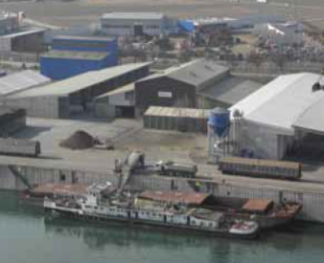
Further developments of Multimodal Transport
Intermodality
  transport with at least two transport means/modes
    only loading units not the cargo itself are transshipped
    e.g. container transport
Comodality
  efficient use of one or different transport modes
  encourages use of alternative transport modes
Synchromodality
  combination of inter- and comodality
  efficient and cooperative use of one or different transport modes
  avoid unimodal transport
  real-time switching between transport modes
source: Danubia Speicherei GesmbH
Notes:
Intermodal transport can be classified as a special type of multimodal transport, whereby two or more modes of transport are used to transport the same loading unit or road vehicle. This means that, when changing transport means, only the loading units or the road vehicles are switched, while the goods remain in the same transport receptacles (such as containers or swap bodies). Since only loading units or the road vehicles (and not the goods themselves) have to be handled, changing the transport mode requires very little time and helps saving on costs for transshipment. In addition, the risk of damage to the goods during transshipment is minimized.
Since the European Commission reinforced its activities to shift freight transport from road to other modes of transport, co-modality can be seen as a transport concept which supports this goal. The main usage of this term was to achieve a mental shift in the understanding of sustainable freight.
Synchromodality finally combines the concept of intermodality and co-modality and therefore aims to optimally use the existing transport resources by combining the different means of transport.
Sources:
Viadonau „Manual on Danube Navigation“, p. 175.
http://www.ejtir.tudelft.nl/issues/2006_04/pdf/2006_04_04.pdf p.367
http://www.synchromodaliteit.nl/en/definition/
Results of Internal report „SynChain“ (2015) – for further information about the used source please contact us

Slide 13
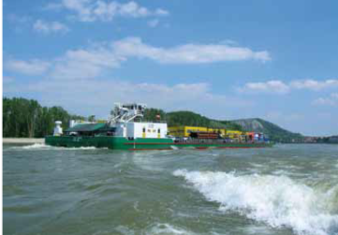
Promotion of
Combined Transport in Austria
source: viadonau
large rise of freight traffic volume →funding on
national and international scale needed for
modal shift
EU-Directive to liberalize
pre- and end-haulage of combined transport
raise attractiveness of combined transport by:
  simplifying cross-border transport
  benefits concerning road vehicle tax (e.g. exemption from tax)
  financial subsidies
  other advantages: exceptions to the bans on night-time driving, weekends and public holiday, etc.…
Notes:
Ways of achieving the enforced use of combined transport consist of various funding schemes on a national and international scale as well as fiscal and regulatory measures.
Promotion of combined transport in Austria:
Financial subsidies: Investment costs and operational expenses for
combined transport are co-funded by specific funding programmes by
the Federal Ministry for Transport, Innovation and Technology on the
condition that certain funding criteria are met (e.g. funding of terminals or
innovation programme on combined transport).
Benefits concerning road vehicle tax: Road vehicles which are registered
in Austria and exclusively used for pre- or end-haulage to the nearest
terminal which is technically suitable for combined transport are exempt
from tax. (Motor Vehicles Tax Act, Federal Law Gazette 449/1992)
Exceptions to the ban on night-time driving: In general, trips made by
trucks over 7.5 tons of total laden weight are prohibited between 10 p.m.
and 5 a.m.; as an exemption, trips involving combined transport on clearly
defined routes between border crossings are allowed during this period.
(Road Traffic Code, Federal Law Gazette 159/1960 and Ordinance
1027/1994)
Exceptions to the ban on driving on weekends and public holidays:
Basically, journeys from 3 p.m. to 12 p.m. on Saturdays as well as on
Sundays and public holidays from midnight to 10 p.m. are prohibited for
trucks and articulated vehicles with more than 3.5 resp. 7.5 tons of total
laden weight. However, the regulation permits trips during this time if they
are part of combined transport that takes place near defined railway stations
and ports. (Road Traffic Code, Federal Law Gazette 159/1960 and
Ordinance 855/1994)
Exceptions to the driving ban to relieve summer traffic: On Saturdays
during holiday time (July and August), all trucks or articulated vehicles of
more than 7.5 tons of total laden weight are prohibited from driving between
8 a.m. resp. 9 a.m. and 3 p.m.; as an exemption, trips in combined
transport to or from the nearest technically suitable combined transport
terminal are allowed (Driving Ban Calendar, Federal Law Gazette II
131/2011).
Compensation of payloads: During combined transport, the total laden
weight of the vehicle for pre- or end-haulage can be increased from 40
tons up to 44 tons. (Motor Vehicles Act, Federal Law Gazette 267/1967)
Liberalizations: Cross-border pre- and end-haulage are liberalized for
vehicles which are registered in the EEA region and have a community
license (Ordinance, Federal Law Gazette II 39/1997). Furthermore, for
pre- and end-haulage in road corridors to four big Austrian rolling road
terminals, no bilateral permission is required.
Rest periods on rolling and floating roads: The time drivers spend
during a trip on rolling or floating roads can be legally declared as resting
periods according to European law. (Directive 561/2006/EC and Working
Hours Act, Federal Law Gazette 461/1969).
Viadonau „Manual on Danube Navigation“, p.187-188

Slide 14
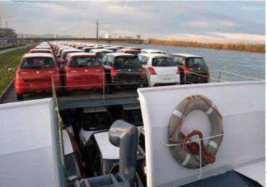
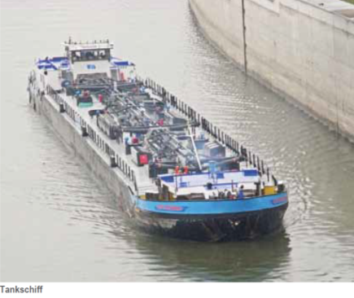

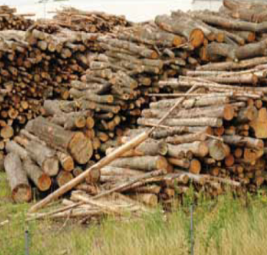
Inland navigation in multimodal transport
Strengths
Low transport costs
Ability to convey large quantities of goods per unit
Environmental friendliness
Safety
Availability around the clock
Low infrastructure costs
Current markets:
Dry cargo (ore, raw material oil, agricultural and forestry products)
Bulk cargo (Petroleum products)
Other cargo (Construction material, used materials and waste, new cars, biogenic row materials, heavy/oversized goods)
  Currently, transport distances greater than 300 km are especially attractive for inland navigation.
Source: via donau
Source: via donau
Source: via donau
Notes:
The strengths of Danube navigation lie mainly with its ability to convey large quantities of goods per vessel unit, its low transport costs and its environmental friendliness. Furthermore, it is available around the clock, with no prohibition on driving at weekends or during the night. In addition, it has a high level of safety and low infrastructure costs.
Therefore the transportation of dry cargo, bulk cargo and other cargo like new cars or construction material is performed by inland vessels. Ore, raw material oil or agricultural and forestry products can be assigned to the dry cargo market, whereas bulk cargo mostly comprises petroleum products.
Sources:
Manual on danube navigation p.19, p. 150-156
https://www.acea.be/uploads/publications/SAG_17.pdf p.7
Annual report viadonau (http://www.rewway.at/en/teaching-materials/annual-report-danube-navigation-austria-2014/) page 18-19.

Slide 15
Agenda
Importance of innovative transport concepts for inland navigation
Freight transport
Physical Internet
Multimodal transport concepts
Synchromodality

Slide 16
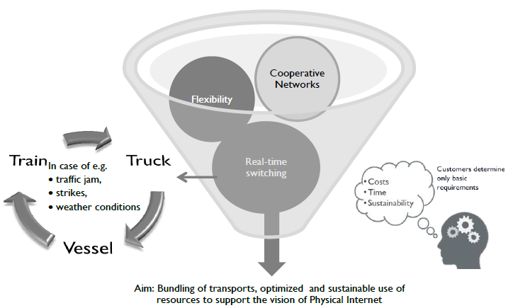
Concept of synchromodality
Synchromodality = freight transport with optimized, cooperative use of different transport modes enabled through real-time transport decisions.
Notes:
As shown in the figure above, synchromodality aims to create a flexible and cooperative transport network by using the different available transport resources. As a consequence reliability, robustness and resilience of the transport network should be increased by introducing real-time monitoring of the transport chains and real-time mode and route choice.
This can lead to an increasing use of rail and inland waterway transportation due to bundling effects and the elimination of common prejudices of decision makers. The main precondition for the concept of synchromodality is that the transport mode is not defined by the client which enables bundling effects. The customer can only determine basic requirements like the costs of the transport and the delivery time.
To guarantee a success of this concept, a close cooperation between all actors along the supply chain is necessary.
Sources:
http://www.intermodal-events.com/files/inland_navigation_paul_ham.pdf Slide 12
Results of Internal report „SynChain“ (2015) – for further information about the used source please contact us

Slide 17
Drivers & barriers
-road congestion
-increasing transport volume (ship size)
-demand for efficient hinterland connections and sustainable transport
- more use of rail and inland shipping
-mind shift
-sharing of data
-collaboration with competitors
-amodal booking by the client → give up control
Drivers
Further preconditions:
Volume to enable bundling effects
Accessibility of all modes of transport
high frequencies
Barriers
Notes:
As shown in the video (see source below) drivers, barriers and preconditions for the success of synchromodality can be named.
The current road congestion, the increasing transport volume e.g. at container ports like Rotterdam due to the expanding ship size, the need for efficient hinterland connections and sustainable transport in combination with the wanted modal shift by politics can be named as drivers for synchromodality.
Since one main aspect of synchromodality is amodal booking, which means the client isn’t able to define which transport mode should be used for transportation, the client has to give up control and this loose of control can be seen as a potential barrier. Also the sharing of market relevant data with competitors which could lead to a loss of a market advantage and therefore can be named as a barrier because of the lack of trust in collaboration. In addition a mind shift is needed to overcome these barriers.
As a consequence these barriers need to be considered when implementing synchromodality.
In addition besides the accessibility of all modes of transport, high frequencies and high volumes are needed to enable bundling affects. This means that synchromodality can be more successful when more parties along the supply chain are working together.
Source:
https://www.youtube.com/watch?v=5ofhMxRRyec

Slide 18
Benefits
CO₂ reduction
Real-time monitoring, mode and route choice
Flexible transport network
  Effective utilization of infrastructure
  Reduction of waiting times
Central contact person → small service providers
Prejudices of decision makers in respect to rail and inland waterway transportation can be overcome
Financial benefits because of high capacity utilization
Notes:
The benefits of synchromodality are the following: Due to bundling effects and therefore an efficient use of the transportation capacity, additional transport distances can be avoided which leads to an decrease in CO2 and other emissions. The real-time monitoring makes a mode and route choice possible whenever its beneficial. This enables an effective utilization of the infrastructure and a reduction of waiting times. All in all a flexible transport network is created. The benefit for small service providers is that they have one central contact person who coordinates the transports. Furthermore prejudices of decision makers about rail and inland waterway transportation can be overcome. Besides the ecological benefits also financial benefits can be realized due to high capacity utilization. This is especially beneficial for shippers and also customers.
Source:
https://www.youtube.com/watch?v=5ofhMxRRyec

Slide 19
Successful pilot in Netherlands
Key factors
  experiences in trade
  pioneer spirit
  necessary requirements for
  synchromodality are fulfilled
    logistical size
    network – connection via all
    transport modes
Successful pilots
  European Gateway services (2008)
  Rotterdam – Tilburg (2011)
 | 2010 | 2033 (target) | Synchro- Pilot
truck | 57% | 35% | 19%
barge | 33% | 45% | 46%
rail | 10% | 20% | 35%
Modal split for Rotterdam port 2010 (corridor Rotterdam to Tilburg)
Notes:
The success of the Netherlands in the field of synchromodality can be explained by the core competence of the Netherlands. They are the leader in handling of cargo flows due to their experience in trade and their pioneer spirit. In addition the Netherlands, especially the Port of Rotterdam, meet the conditions for the success of synchromodality – the logistical size of the transports and the infrastructure network to enable multimodal transport.
Therefore the Netherlands already leaded successful pilots in connection with synchromodality. One is named European Gateway services and was launched in 2008 and offers an integrated network of inland terminals with high frequent rail and barge connections.
Another pilot launched in 2011 on the corridor from Rotterdam to Tilburg which included a tri-modal network where shippers booked mode free and the best transport lane was selected for each container. As shown in the table, the results in the modal split outperform the targeted percentages for 2033.
Whereas transport by barge “just” meets the targeted percentage, rail has an even higher share and the percentage of truck was radically reduced.
Nevertheless it need to be considered that the topography of the Netherlands is different in comparison to other countries in Europe. Therefore one may say, that the appropriate infrastructure can lead to a bigger success of synchromodality.
Sources:
http://www.synchromodaliteit.nl/en/opportunities/
http://www.digitimes.com.tw/tw/B2B/Seminar/Service/download/0519802260/0226DAF-05B.pdf (slide 9)
http://www.co3-project.eu/wo3/wp-content/uploads/2011/12/CO3-D-2-3-Position-Paper-on-Co-modality_def.pdf p.13
http://www.europeangatewayservices.com/content/synchromodal-transport

Slide 20
Potential for inland navigation
Synchromodality
bundling effects are possible → inland waterway transport becomes more attractive
prejudices can be overcome
in accordance with political goals → modal shift
decision for transport mode is centralized → personal preferences are sidelined
spare capacity of waterway
only 15 % of capacity are used on the Danube!
Notes:
Synchromodality also offers some potentials for inland navigation: by installing certain turnover points bundling effects are possible and therefore higher volumes can be transported at once. Since inland vessels are especially attractive for transports with higher volume this bundling affects promote inland navigation.
Furthermore because of amodal booking (shipper doesn‘t choose transport mode) current prejudices can be overcome and strengthen the image of inland navigation as a reliable transport option.
Shifting transport from road to other transport modes is also in accordance with the political goals.
Since personal preferences are besides other factors essential in the decision making for transport modes, by centralizing the decision process personal preferences are sidelined.
Another opportunity for inland navigation is that there‘s a lot of spare capacity of waterway in Europe, e.g. only 15% of the capacity are used on the Danube.
http://www.scs.fraunhofer.de/content/dam/scs/de/dokumente/studien/Wirtschaftliche_Rahmenbedingungen_des_Gueterverkehrs.pdf p.14
http://wirtschaftsblatt.at/home/nachrichten/oesterreich/1425681/85-Prozent-der-Donau-bleiben-ungenutzt
https://www.youtube.com/watch?v=5ofhMxRRyec

Slide 21
Agenda
Importance of innovative transport concepts for inland navigation
Freight transport
Physical Internet
Multimodal transport concepts
Synchromodality

Slide 22
What is the „Physical Internet“?!
Internet
Shipping products over the internet – just like information flows!
sender
receiver
Physical
Internet
HUB
HUB
HUB
HUB
Customer
Notes:
The idea of the physical internet is to ship freight just like information flows via the internet. When sending an email, in the most cases you don‘t know which provider is used by the receiver or which route the email takes. You rely on the Internet to securely send your email to the indented recipient. In the physical internet the message is a physical object like a parcel. A network of hubs which send and receive products form the foundation for the physical internet, modelled after the different servers in the internet. The closest hub to the customer/receiver performs the last delivery. In the physical internet all transport modes and service providers are connected to guarantee an efficient shipment and efficient use of the network.
Source:
https://www.youtube.com/watch?v=lltcWVNrjl0

Slide 23
Definition
Physical Internet
„The Physical Internet is an open global logistics system founded on physical, digital and operational interconnectivity through encapsulation, interfaces and protocols. It enables an efficient, sustainable, adaptable and resilient Logistic Web.“ Montreuil B., Meller R.D., Ballot E. (2012)
foundation
smart network
standards
real-time
sharing
innovations
multimodality
Notes:
The Canadian professor Benoit Montreuil can be seen as a pioneer in the field of the physical internet. He names thirteen elements which form the foundation of the physical internet. These can be summarized in six categories:
Standardized containers, parcels, warehouses and turnover points need to be installed to guarantee a barrier-free and seamless transport. Also some processes need to be standardized to minimize the risk of discrepancies.
These standardized transport units and processes lead to a reliable and resilient smart network where the units communicate almost independently. This smart network should be open for all supply chain actors and on a global level as well. Together, this makes simplification possible, since transport units chose the best transport route on their own and interact with other transport units and stations. This makes a human interaction almost unnecessary (e.g. planning transshipments from one transport mode to another).
The connection between the actors, the infrastructure and the different transport modes is essential for the physical internet and leads to a comprehensive interconnectivity. The sharing of all relevant information and to guarantee the topicality of the data in a real-time manner are also crucial elements for the concept of the physical internet. Furthermore innovations in connection with new business models and infrastructure should be promoted to enable further development for the physical internet.
Source:
http://www.physicalinternetinitiative.org/Physical%20Internet%20Manifesto_ENG_Version%201.11.1%202012-11-28.pdf (slide 21)
http://physicalinternetinitiative.org/Towards%20a%20Physical%20Internet%20-%20Document%20-%20Benoit%20Montreuil.pdf (p7-23)

Slide 24
Why we need the Physical Internet
Storage and transfer centers aren‘t used efficient
Trucks and containers are often empty or half empty
Transport routes aren‘t optimal
„the way physical objects are moved, stored, realized, supplied and used throughout the world is economically, environmentally and socially inefficient and unsustainable“
Montreuil B., Lounès M. (2012)
No fast, reliable and affordable access and mobility of physical objects for most people
High greenhouse gas emissions, energy consumption, pollution and material waste in logistics
Transport modes aren‘t linked nor coordinated
Notes:
As shown on the slide above there are many facts which promote the physical internet.
Source:
http://www.physicalinternetinitiative.org/Physical%20Internet%20Manifesto_ENG_Version%201.11.1%202012-11-28.pdf Slide 8-9
http://www.google.at/url?sa=t&rct=j&q=&esrc=s&source=web&cd=1&cad=rja&uact=8&ved=0ahUKEwieoYattZXLAhXFNpoKHZDTAiEQFggbMAA&url=http%3A%2F%2Fwww.modulushca.eu%2Findex.php%2Fmodulushca-up-to-date%2Fpublications%3Fdownload%3D9%3Ascience-the-information-highway-gets-physical&usg=AFQjCNGm-0CAjA_e0VR_2Nep0B97_2zfbQ p.1106

Slide 25
Drivers towards the Physical Internet
No efficient use of loading space (air and packaging)
Empty run
Working condition for truckers
Products are stored at the wrong places
Under-used production/storage facilities
Overproduction of products
Products are not where they are needed
Long transport distances
Competitive multimodal transport not possible
City logistics
Existing networks lack security and robustness
Notes:
There are many drivers which encourage the development of the physical internet: Since transport vehicles aren‘t driving fully loaded in the most cases and also packing material accounts for a lot of space in the transport capacity, transport vehicles could be used more efficiently. Also empty runs are very common.
The working conditions for truckers have deteriorated because they are on the road a lot and as a consequence don‘t spend much time at home. This leads to tensions in their family and social life but also affects their health.
In addition products are often not stored at the place of demand which leads to high inventory costs (at the wrong places) and to long delivery times for the customer. As a consequence production and storage facilities are under or badly used. A high percentage of the produced products isn‘t used at all (e.g. food industry) and is thrown away whereby less developed countries really need them.
Because of globalization you can order products from almost every country which leads to very long transport distances.
Currently multimodal transport still needs a lot of coordination and is connected with handling costs for transshipments which makes it still unprofitable in the most cases. As already mentioned the increasing size of cities is especially difficult for transportation in the center of the city.
At the moment existing networks still lack security and robustness which makes collaboration between different actors along the supply chain even more difficult because of the lack of trust in collaboration.
Sources:
http://www.physicalinternetinitiative.org/Physical%20Internet%20Manifesto_ENG_Version%201.11.1%202012-11-28.pdf (Slide 11-13)

Slide 26
Potential barriers
Physical Internet
New area of operation for most companies → mind shift necessary
Sharing
  assets like trucks and warehouses → less property
  information about customers, shipping routes, markets
Fear of losing advantage in knowledge
Network instead of one-to-one agreements
Products and containers are not standard/modular
Notes:
Since the physical internet is still a new area of operation for most companies and therefore connected with an uncertainty. Therefore a mind shift is necessary to encourage the common use of the physical internet.
One main aspect of the physical internet is the idea of sharing – sharing assets like trucks and warehouses which means less property and as a consequence less control for one company and also sharing important information about customers, shipping routes and markets which are the most valuable assets of a company. Therefore a lot of companies have the fear to lose their market advantage.
Another fact is that the idea is to have a network instead of one-to-one agreements between few actors in the supply chain.
Furthermore at the moment products and containers are not standard/modular which makes transshipment complicated and bundling effects are difficult to realize.
In summary, especially the needed mind shift and therefore building of mutual trust is needed in many cases to guarantee the success of the physical internet.
Source:
http://www.google.at/url?sa=t&rct=j&q=&esrc=s&source=web&cd=1&cad=rja&uact=8&ved=0ahUKEwieoYattZXLAhXFNpoKHZDTAiEQFggbMAA&url=http%3A%2F%2Fwww.modulushca.eu%2Findex.php%2Fmodulushca-up-to-date%2Fpublications%3Fdownload%3D9%3Ascience-the-information-highway-gets-physical&usg=AFQjCNGm-0CAjA_e0VR_2Nep0B97_2zfbQ
p. 1106

Slide 27
Pioneer: „smartPORT Logistics“ - Hamburg (Germany)
“Our aim is to gradually interconnect all modes of transport – from waterways and roads all the way to the railway”
Dr. Sebastian Saxe (2012)
  goal: optimizing land transport due to limited road capacity (preventing congestion and waiting times), interlink traffic and freight
  → know exactly when a container needs to moved
  cloud-based IT platform (SAP) used by transport and logistic partners
  control instrument – navigation within & outside port area while considering current traffic movements
  apps for truck drivers – avoid traffic jams, stress and waiting time, freight documents can be transmitted
  movement of trucks can be monitored via GPS
  information extracted only for a defined radius for the specific route section
  Partners: T-System, SAP, ADAC, TRUCKinform, Hamburg Port Authority, EKB Container Logistik, Stapelfeldt, GLOMB
Notes:
A pioneer in the field of the physical internet in connection with inland navigation is the port of Hamburg. The goal of the pioneer „smartPORT Logistics“ is to optimize land transport due to the limited road capacity, by interlinking traffic and freight and therefore know when a container needs to be moved.
A cloud-based IT platform, provided by SAP, is used to link all the transport and logistic partners and to share all the relevant information about e.g. specific route sections. By monitoring the movements of trucks via GPS, alternative routes can be recommended in real-time and help to avoid waiting times and stress because of traffic jams. Furthermore a control instrument points the way inside and outside the port are while simultaneously considering current traffic movements. There are also apps for truck drivers to simplify the communication with other parties like the transmitting of freight documents. Besides SAP there are many other partners to make all this possible.
Sources:
http://www.hamburg-port-authority.de/en/press/Brochures-and-publications/Documents/HPA_AnnualReport_image2012.pdf p.13-15

Slide 28
Potential for inland navigation
Physical Internet
ports as main turnover point → increasing use of inland navigation
strengthening position as a part of the network → unimodal not favorable
standardized and modular shipping containers
availability and spare capacity
integration of existing information services: DoRIS (Danube River Information Services)
modal shift demanded by politics and society
Notes:
As the pioneer on the previous slide shows, ports can be seen as main turnover points and by including them into the network of the Physical Internet bundling effects can be achieved and therefore an increasing use of transport by inland vessels could be achieved. In this context also the position of ports and inland navigation in general can be strengthened as a part of the network, since unimodal transport by inland navigation isn‘t possible in the most cases and also not favorable.
By defining standardized and modular shipping containers the transport by inland vessel can be even more attractive because of lower handling costs for transshipments.
Another opportunity of inland navigation is it‘s availability around the clock, with no prohibition on driving at weekends or during the night and its spare capacity (as already mentioned in the section before, only 15% of the capacity are used on the Danube).
Furthermore there are already existing information services like DoRIS for the Danube in Austria which could be easily integrated in the network of the physical internet.
In addition the demanded modal shift by politics and society is also in benefit of inland navigation!
Source:
Viadonau „manual on Danube navigation“ p.18, 129
http://www.doris.bmvit.gv.at/en/

Slide 29
Conclusion
Importance of innovative transport concepts for inland navigation
new transport concepts are needed → combination of different transport modes
time = critical resource → real-time data
benefits for inland navigation:
  new decision making processes (prejudices can be overcome)
  ports as main turnover points
  bundling effects
  spare capacity, availability
  respecting political goals
  existing information system (DoRIS)
Notes:
In summary new transport concepts are needed due to the trends influencing freight transport and other developments (e.g. increasing freight transport in general, bottle-necks in transport infrastructure,…). In general one may say, that the current bottle-necks in resources like infrastructure and the negative effects of the transport volume make new transport concepts necessary. Therefore the combination of different transport modes and thus the combination of the different strengths of the transport modes can be seen as a solution to the problems we are facing. As a consequence multimodal transport concepts which respect the future developments are needed.
Since time is a critical resource nowadays, also for the transport industry, information services and real-time data are crucial for further concepts.
For inland navigation the benefits of new transport concepts like synchromodality or the physical internet are the following:
By having a new decision making process and eliminating personal preferences, current prejudices can be overcome and strengthen the position of inland navigation. Ports can be integrated as main turnover points into the network and by achieving bundling effects inland navigation becomes more attractive. This can be reinforced because of the spare capacity and the availability of inland waterways. As a consequence the current weakness of low network connectivity and the requirement of pre- and end-haulage could be overcome.
Furthermore political goals are respected by choosing transport by inland vessels. Since data are especially relevant for future transport concepts existing information systems like DoRIS in Austria can be integrated.

Slide 30
Sources
Holderied, C. (2005): Güterverkehr, Spedition und Logistik. Managementkonzepte für Güterverkehrsbetriebe, Speditionsunternehmen und logistische Dienstleister, München.
Bretzke, W./Barkawi K. (2010): Nachhaltige Logistik: Antworten auf eine globale Herausforderung, Berlin Heidelberg.
Lehmacher W. (2015): Wirtschaft, Gesellschaft und Logistik 2050 in Logistik – eine Industrie, die (sich) bewegt. Strategien und Lösungen entlang der Supply Chain 4.0, Wiesbaden.
Eurostat (2015): Freight transport statistics – modal split. Online: http://ec.europa.eu/eurostat/statistics-explained/index.php/Freight_transport_statistics_-_modal_split
European Commission (2013): EU energy, transport and GHG emissions - Trends to 2050 Reference Scenario 2013. Online: http://ec.europa.eu/transport/media/publications/doc/trends-to-2050-update-2013.pdf
International Transport Forum/ OECD (2015): ITF Transport Outlook 2015. Online: http://www.oecd-ilibrary.org/docserver/download/7414021e.pdf?expires=1457012730&id=id&accname=ocid56027859&checksum=F3F96F396835D30F46A01AD6921DC83C
Europe Container Terminals (2011): The future of freight transport – ECT‘s vision on sustainable and reliable European transport. Online: http://www.informatie.binnenvaart.nl/documenten/doc_view/158-the-future-of-freight-transport-ect-s-vision-on-sustainable-and-reliable-european-transport
viadonau (2013): Manual on Danube Navigation, Vienna. Order: http://www.viadonau.org/en/newsroom/publications/manual-on-danube-navigation/
Stead D. (2006): Mid-term of the European Commission‘s 2001 Transport White Paper. Online: http://www.ejtir.tudelft.nl/issues/2006_04/pdf/2006_04_04.pdf p.367
Platform Synchromodalität. Homepage: http://www.synchromodaliteit.nl/en/definition/
Tavasszy L.A./van Meijeren J. (2011): Modal Shift Target for freight transport above 300 km: an assessment, Bruxelles. online: https://www.acea.be/uploads/publications/SAG_17.pdf
Viadonau (2014): Annual Report on Danube Navigation in Austria. http://www.rewway.at/en/teaching-materials/annual-report-danube-navigation-austria-2014/)
Ham P. (2012): European Gateway Services. Online: http://www.intermodal-events.com/files/inland_navigation_paul_ham.pdf

Slide 31
Sources
Synchromodality. Online: https://www.youtube.com/watch?v=5ofhMxRRyec
Synchromodality for the Netherlands. Online: http://www.synchromodaliteit.nl/en/opportunities/
Rancuret K. (2009): Holland: Pioneers in global logistics – Leading European supply chain models. Online: http://www.digitimes.com.tw/tw/B2B/Seminar/Service/download/0519802260/0226DAF-05B.pdf
Rossi S. (2012): Challenges of Co-modality in a collaborative environment. Online: http://www.co3-project.eu/wo3/wp-content/uploads/2011/12/CO3-D-2-3-Position-Paper-on-Co-modality_def.pdf
ECT (2016): Synchromodal transport. Online: http://www.europeangatewayservices.com/content/synchromodal-transport
Fraunhofer Institut (2008): Wirtschaftliche Rahmenbedingungen des Güterverkehrs – Studie zum Vergleich der Verkehrsträger im Rahmen des Logistikprozesses in Deutschland, Nürnberg. Online: http://www.scs.fraunhofer.de/content/dam/scs/de/dokumente/studien/Wirtschaftliche_Rahmenbedingungen_des_Gueterverkehrs.pdf
Wirtschaftsblatt (2013): Schifffahrt: 85 % der Kapazitäten auf der Donau bleiben ungenutzt. Online: http://wirtschaftsblatt.at/home/nachrichten/oesterreich/1425681/85-Prozent-der-Donau-bleiben-ungenutzt
Physical Internet: https://www.youtube.com/watch?v=lltcWVNrjl0
Montreuil B. (2012): Physical Internet Manifesto – transforming the way physical objects are moved, stored, realized, supplied and used, aiming towards greater efficiency and sustainability. Online: http://www.physicalinternetinitiative.org/Physical%20Internet%20Manifesto_ENG_Version%201.11.1%202012-11-28.pdf
Montreuil B. (2011): Towards a Physical Internet: Meeting the Global Logistics Sustainability Grand Challenge. Online: http://physicalinternetinitiative.org/Towards%20a%20Physical%20Internet%20-%20Document%20-%20Benoit%20Montreuil.pdf
Mervis J. (2014): The information highway gets physical – the Physical Internet would move goods the way its namesake moves data. Online: http://www.google.at/url?sa=t&rct=j&q=&esrc=s&source=web&cd=1&cad=rja&uact=8&ved=0ahUKEwieoYattZXLAhXFNpoKHZDTAiEQFggbMAA&url=http%3A%2F%2Fwww.modulushca.eu%2Findex.php%2Fmodulushca-up-to-date%2Fpublications%3Fdownload%3D9%3Ascience-the-information-highway-gets-physical&usg=AFQjCNGm-0CAjA_e0VR_2Nep0B97_2zfbQ
Hamburg Port Authority (2013): REPORT – The Smart Port. Online: http://www.hamburg-port-authority.de/en/press/Brochures-and-publications/Documents/HPA_AnnualReport_image2012.pdf
Viadonau: Donau River Information Services (DoRIS). Online: http://www.doris.bmvit.gv.at/en/

Slide 32


Further Information
We hope our set of slides has met your expectations!
- you are free to use, adapt and share this slides and to use it for your lectures.
For questions and feedback please do not hesitate to contact us:
rewway@fh-steyr.at
Further set of slides are available at:
http://www.rewway.at/en/teaching-materials/bundles/
Maybe you are interested to book a guest lecture or an excursion?
http://www.rewway.at/en/services/

